Slide 1
J2 Innovations’ Automatic RFID Employee Clocking System
Koppany Horvath’s Senior Project

Slide 2


Intro
Koppany Horvath
J2 Innovations
J2 Innovations is a start-up innovating in the field of data visualization for building automation systems (BAS). Our goal is to enhance the way humans interact with the connected world.
Jr. Developer / Linux guy / Hardware manager

Slide 3
Abstract
RFID employee time tracking system
Technologies
IOT enabled ESP32 microcontroller
RFID scanner module
3D printing
WiFi
Softwares
NodeJS framework
Ractive JS library
AM Charts library
MySQL database

Slide 4

Initiation
Background of company
Use Toggl to track employee work hours
Recognize the problem
Current system is paid and closed source
Management can’t see employee schedules
Too easy to modify past data
Why did I select this project?
Both management and employees wanted it
Who are the end users?
All employees at J2 HQ in California

Slide 5
Development
Feasibility of project
Defined scope feasible within deadline
Design of the project
RFID nodes to scan employees
Server to capture RFID events and serve UI
UI to manage everything and add work descriptions

Slide 6
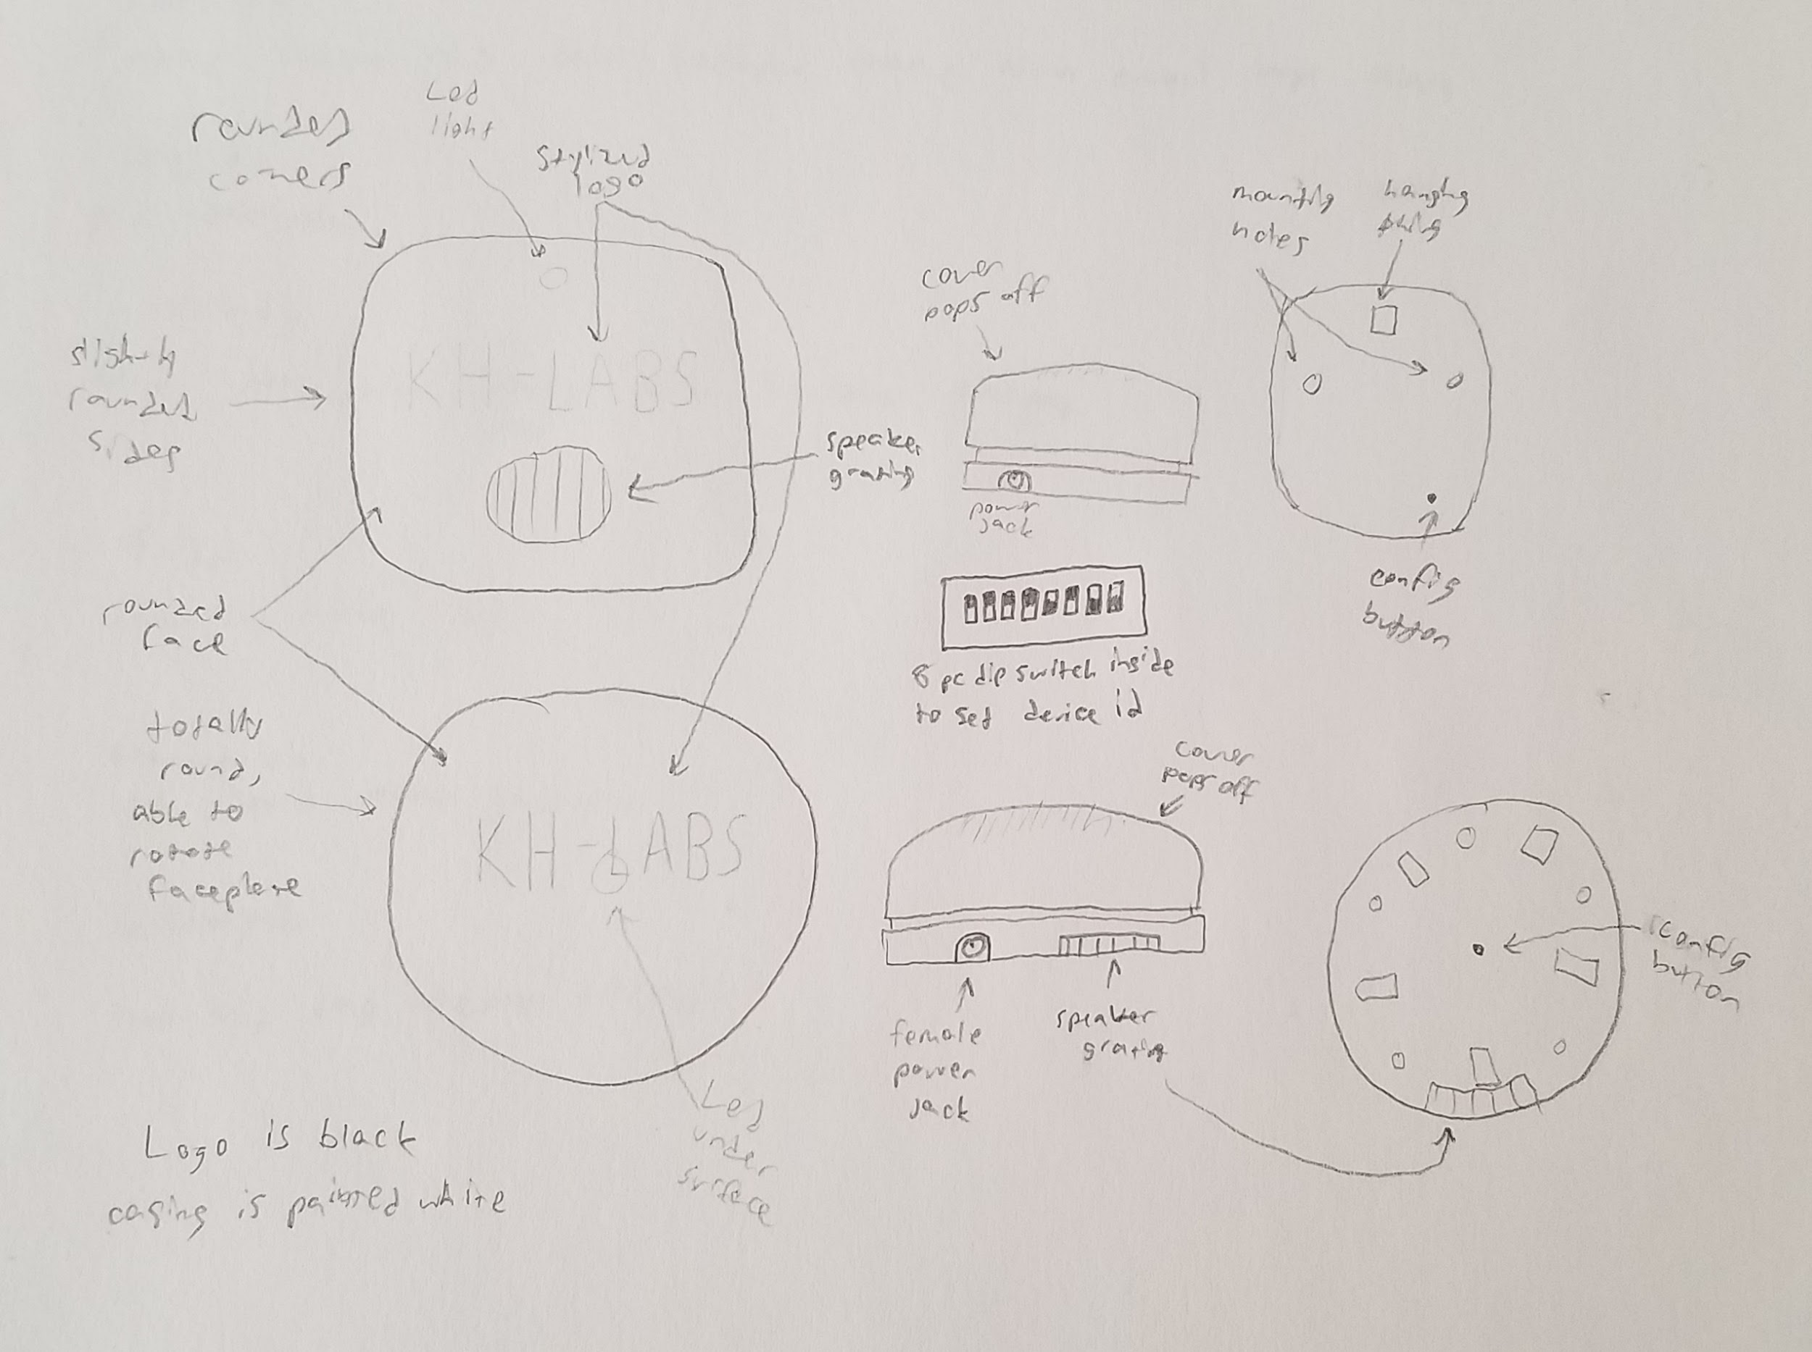
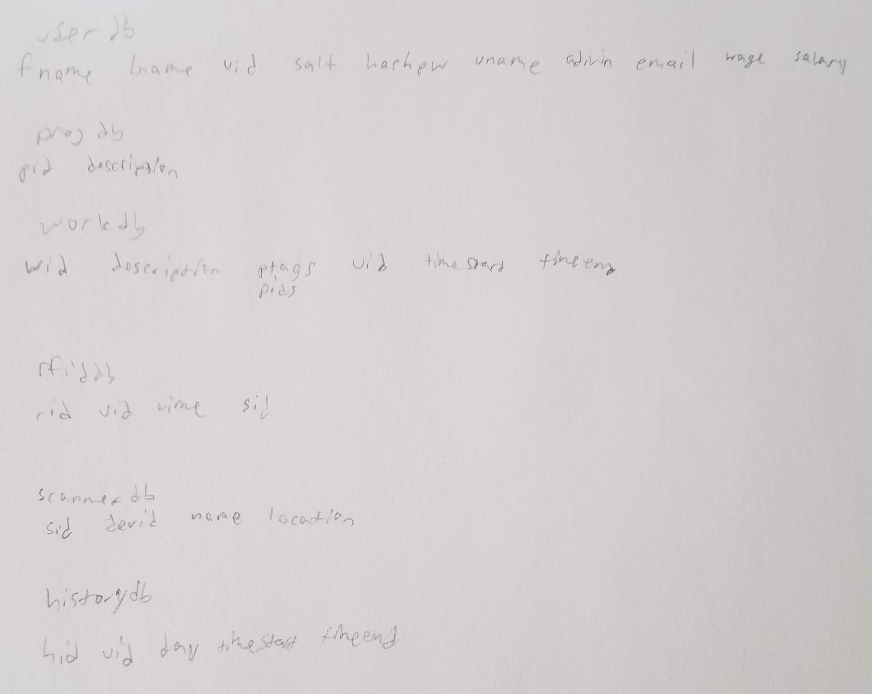
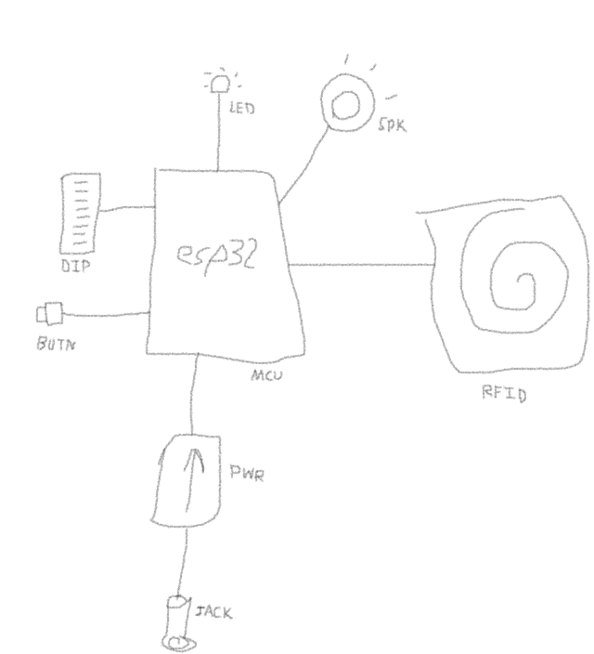
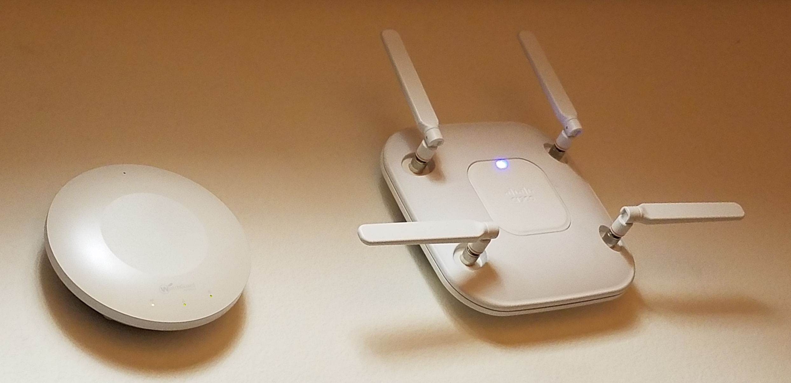
Development

Slide 7
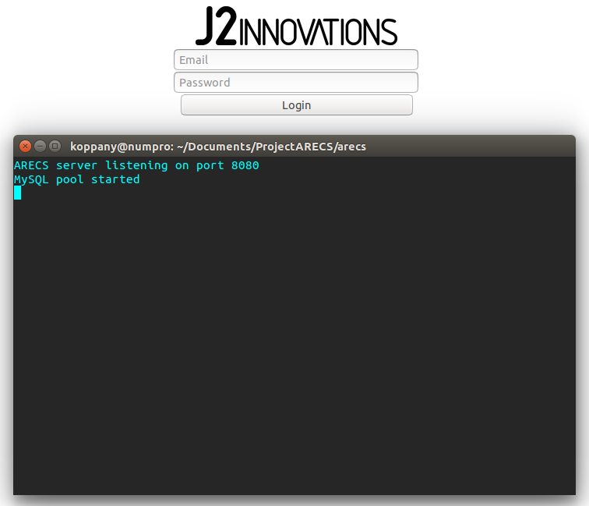
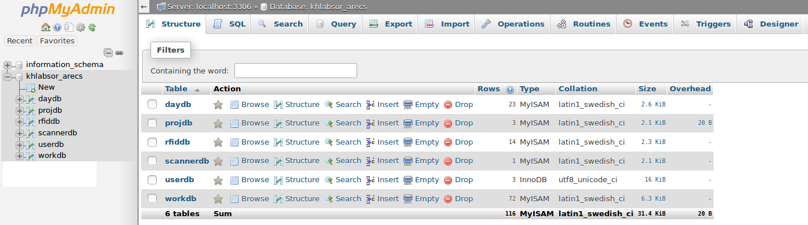
Implementation
Simple login page
Simple web server
First version of database

Slide 8
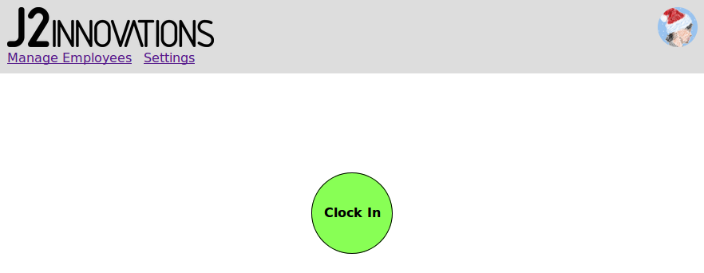
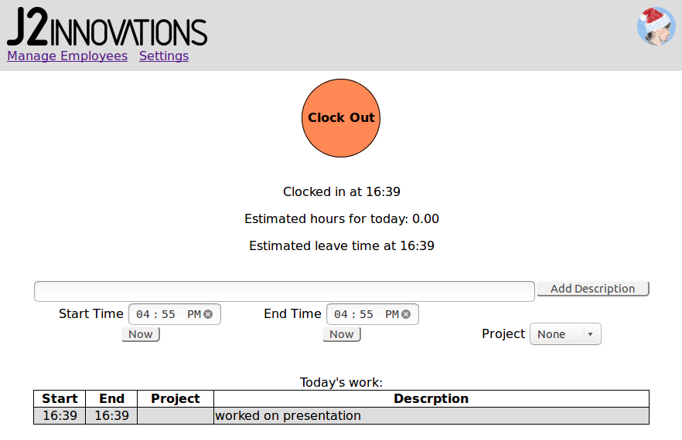
Implementation
Clock in/out page
Updates to server API
Updates to database

Slide 9
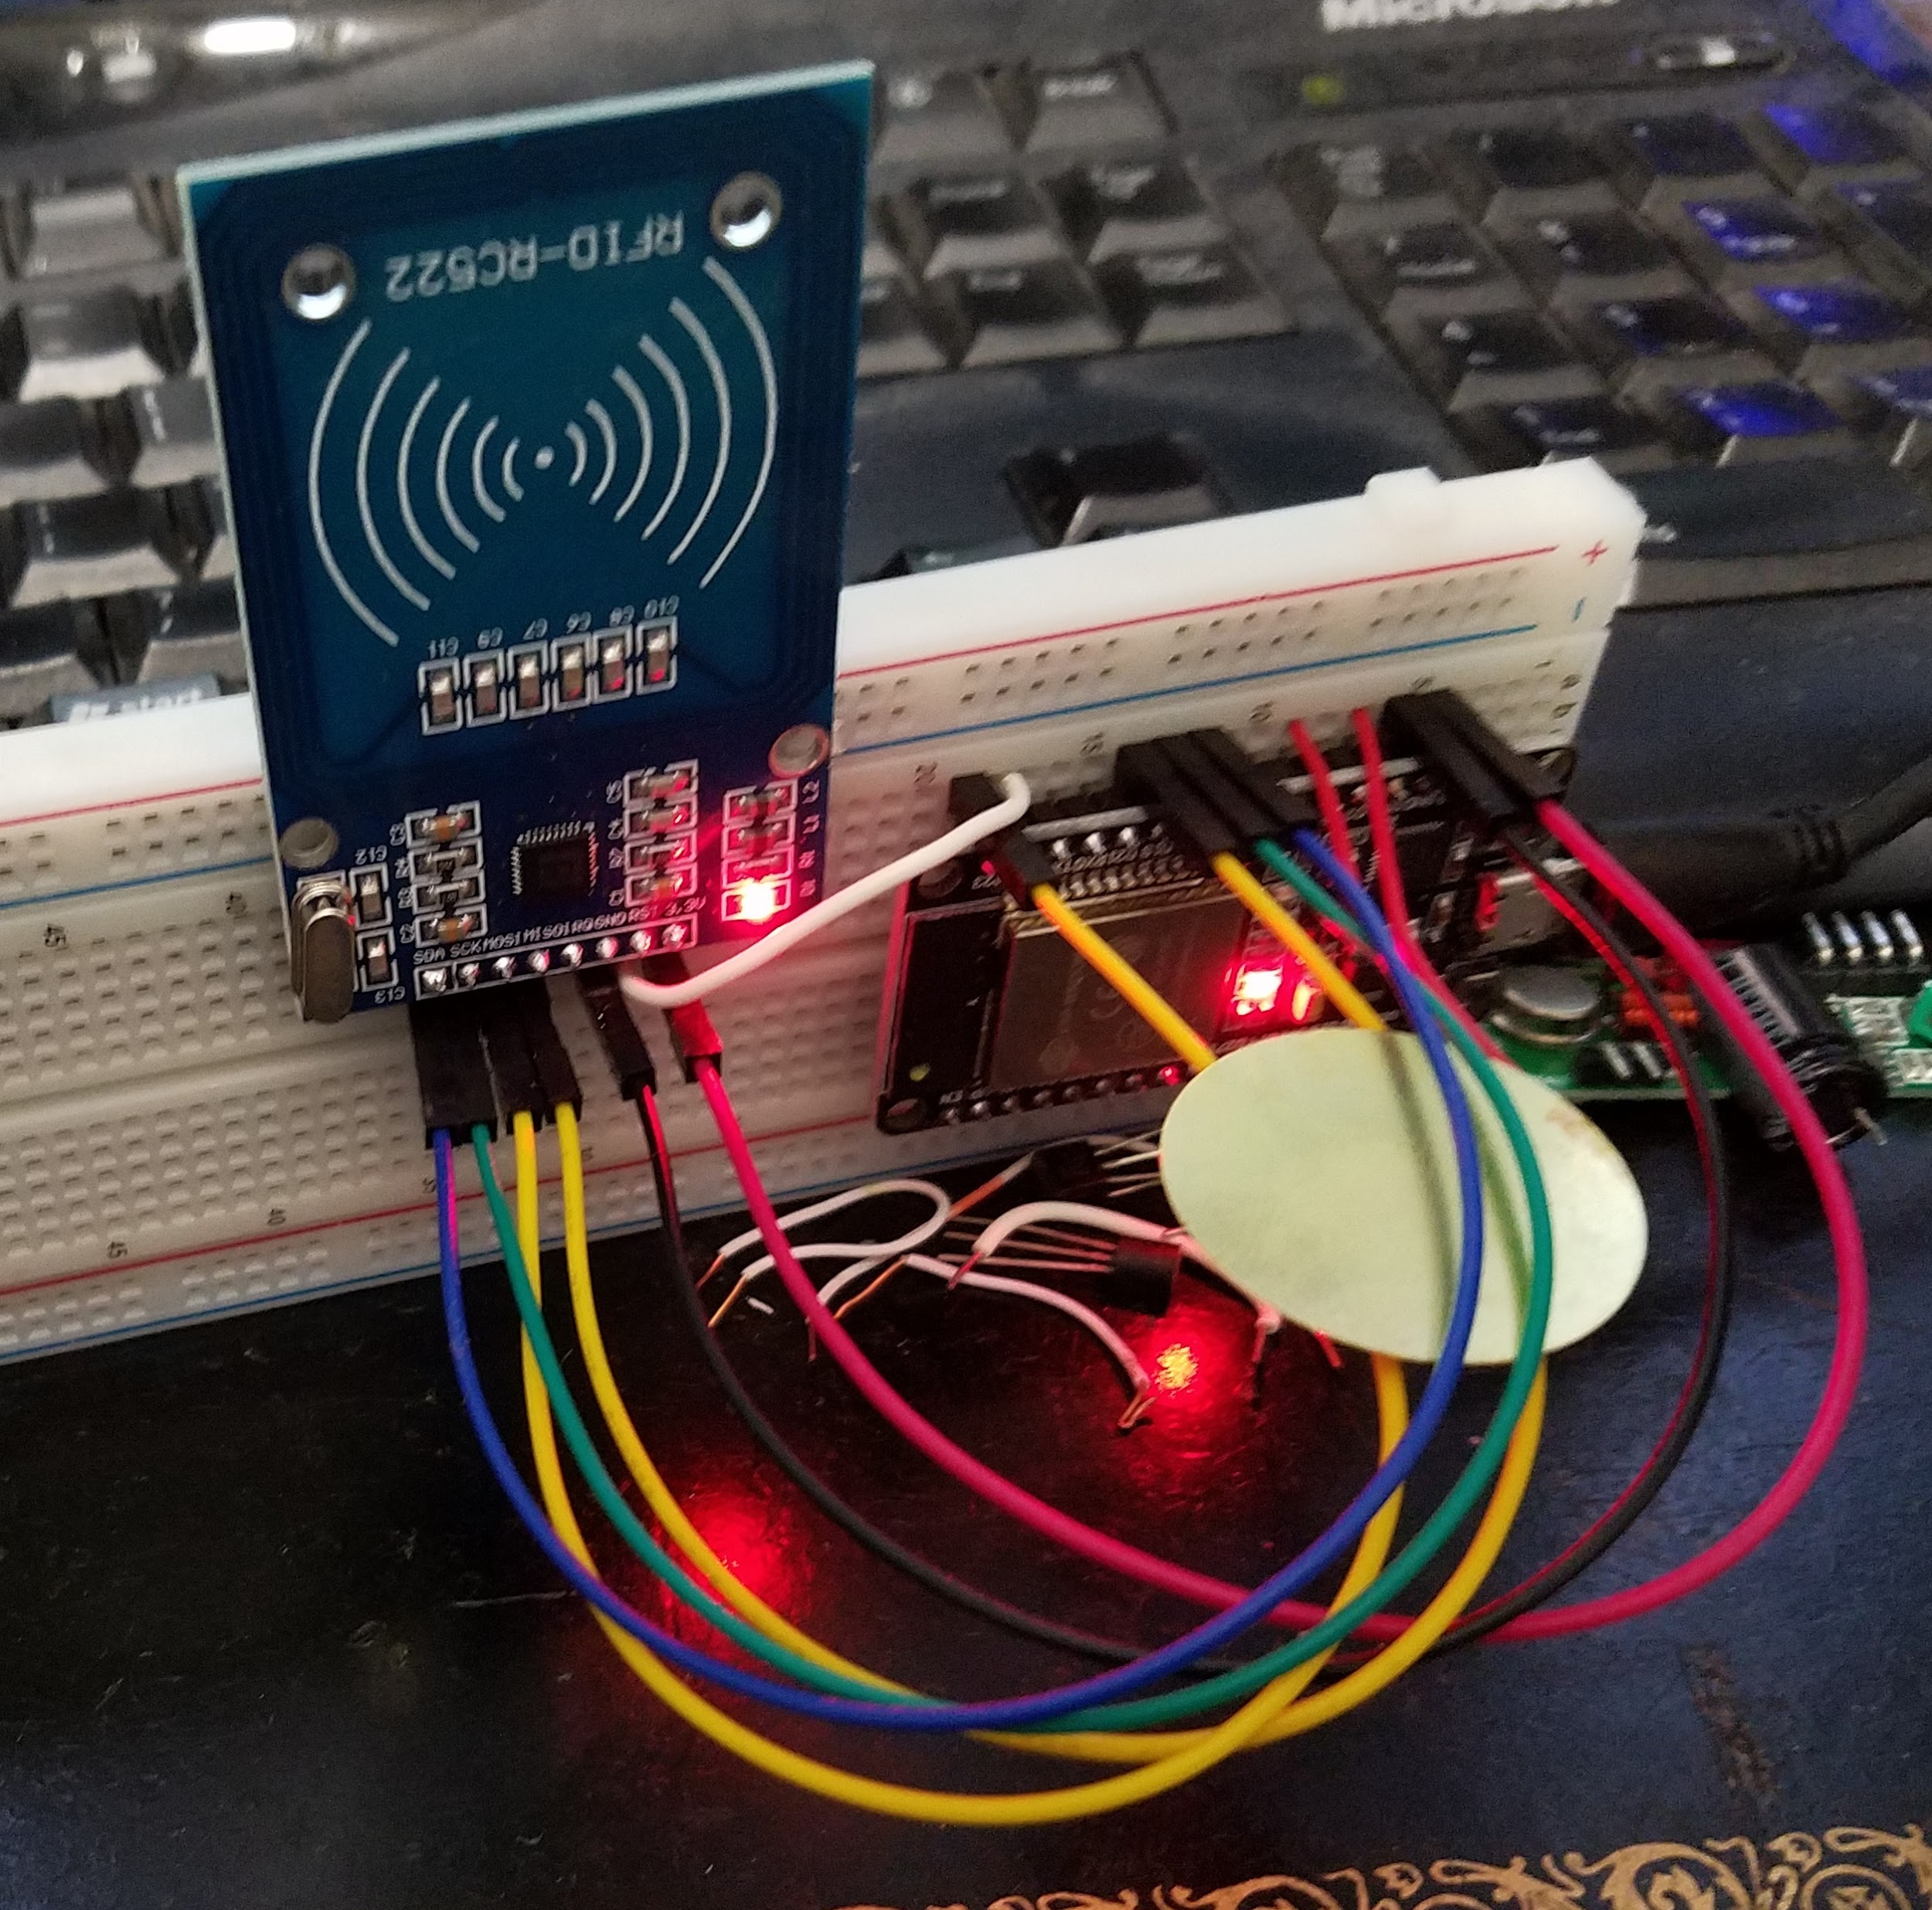
Implementation
Switching over to hardware
Test MCU
Test WiFi capabilities
Test RFID module
Test sound

Slide 10
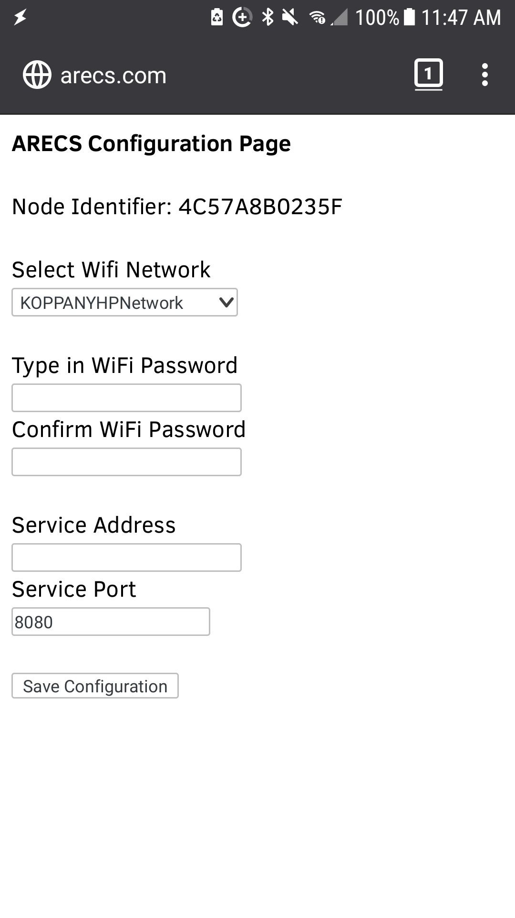
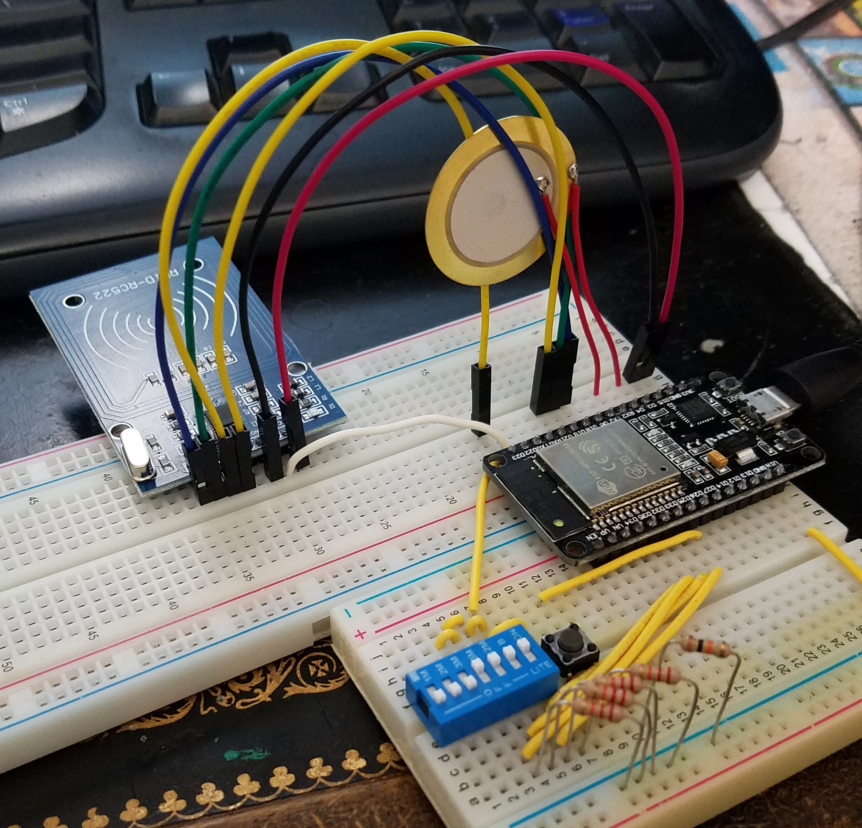
Implementation
Build the full circuit
Write AP routines
Write rest of firmware
Test all modes
Test all features
Update server API
Updates to database

Slide 11
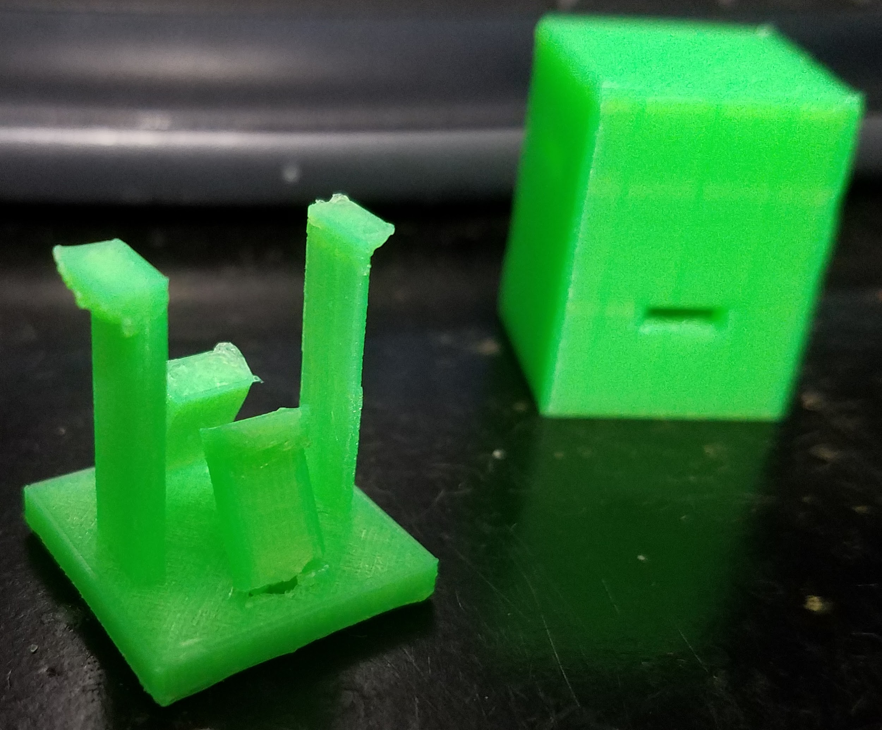
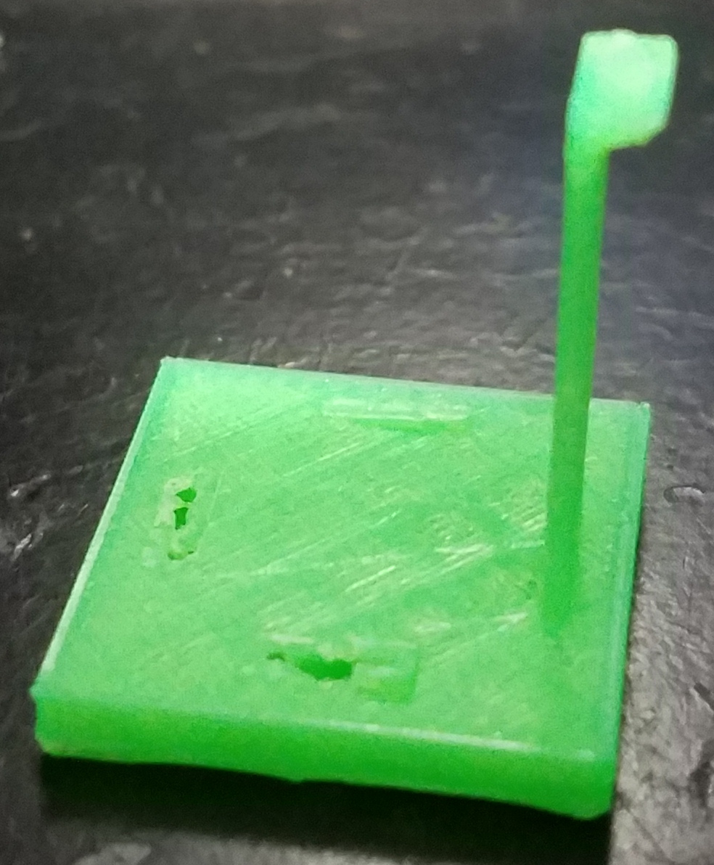
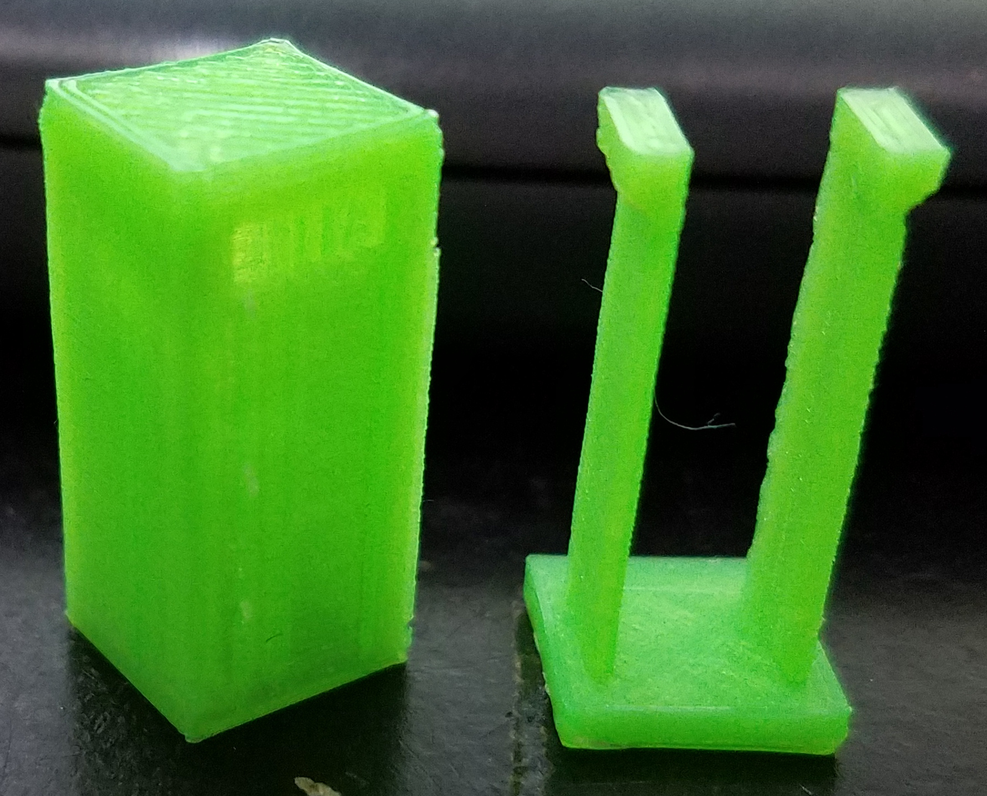
Implementation
3D printed case design
Using snap joints
Trial and error
Alternative needed

Slide 12
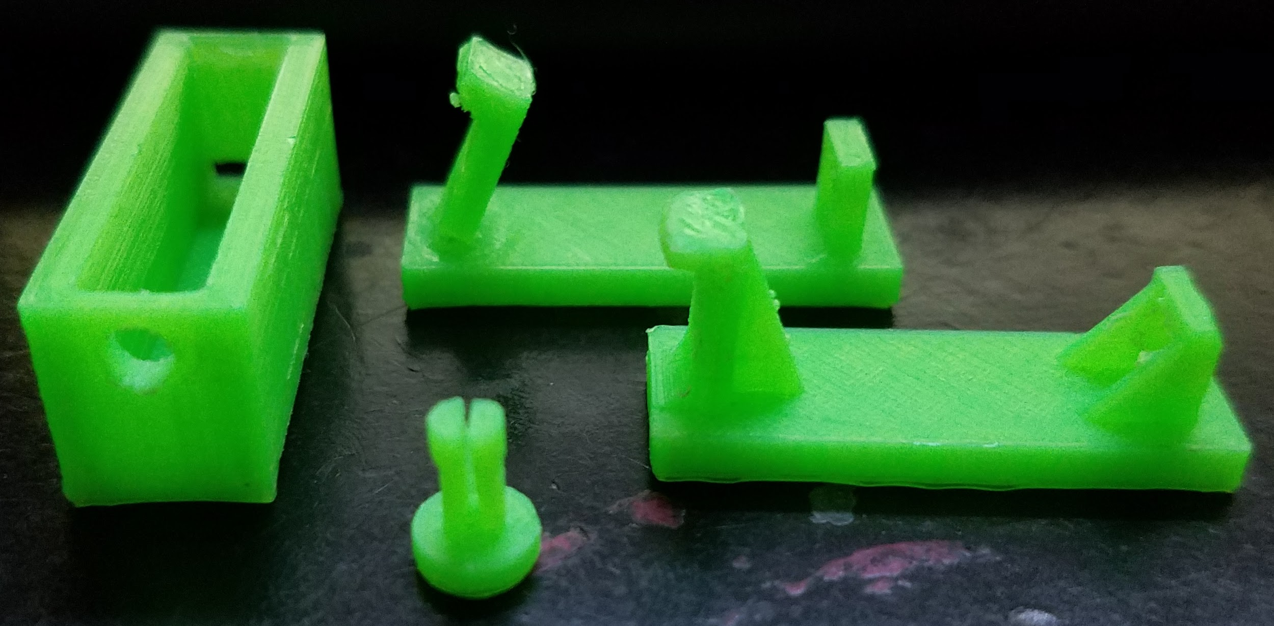
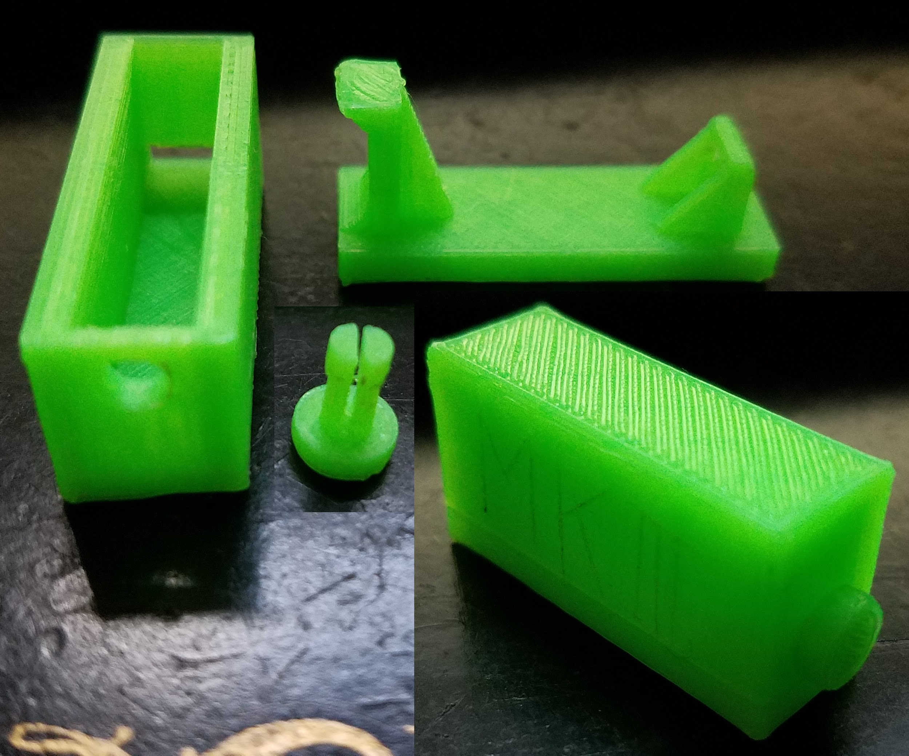
Implementation
3D printed case design
“Pin lock mechanism”
Also trial and error
Easy to implement
Very strong and easy to use
Successful

Slide 13
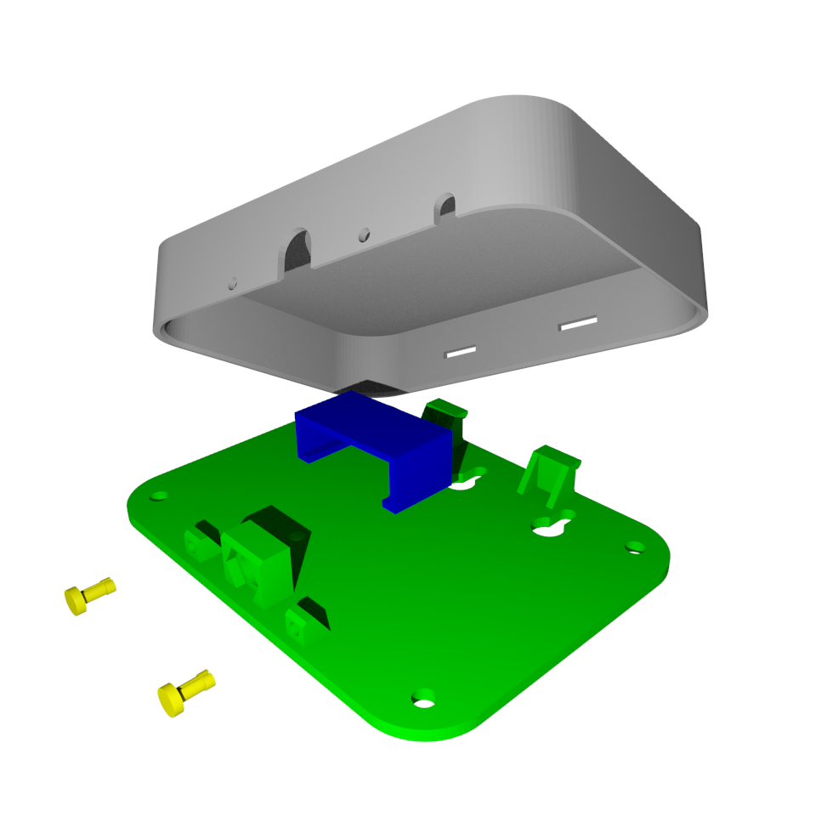
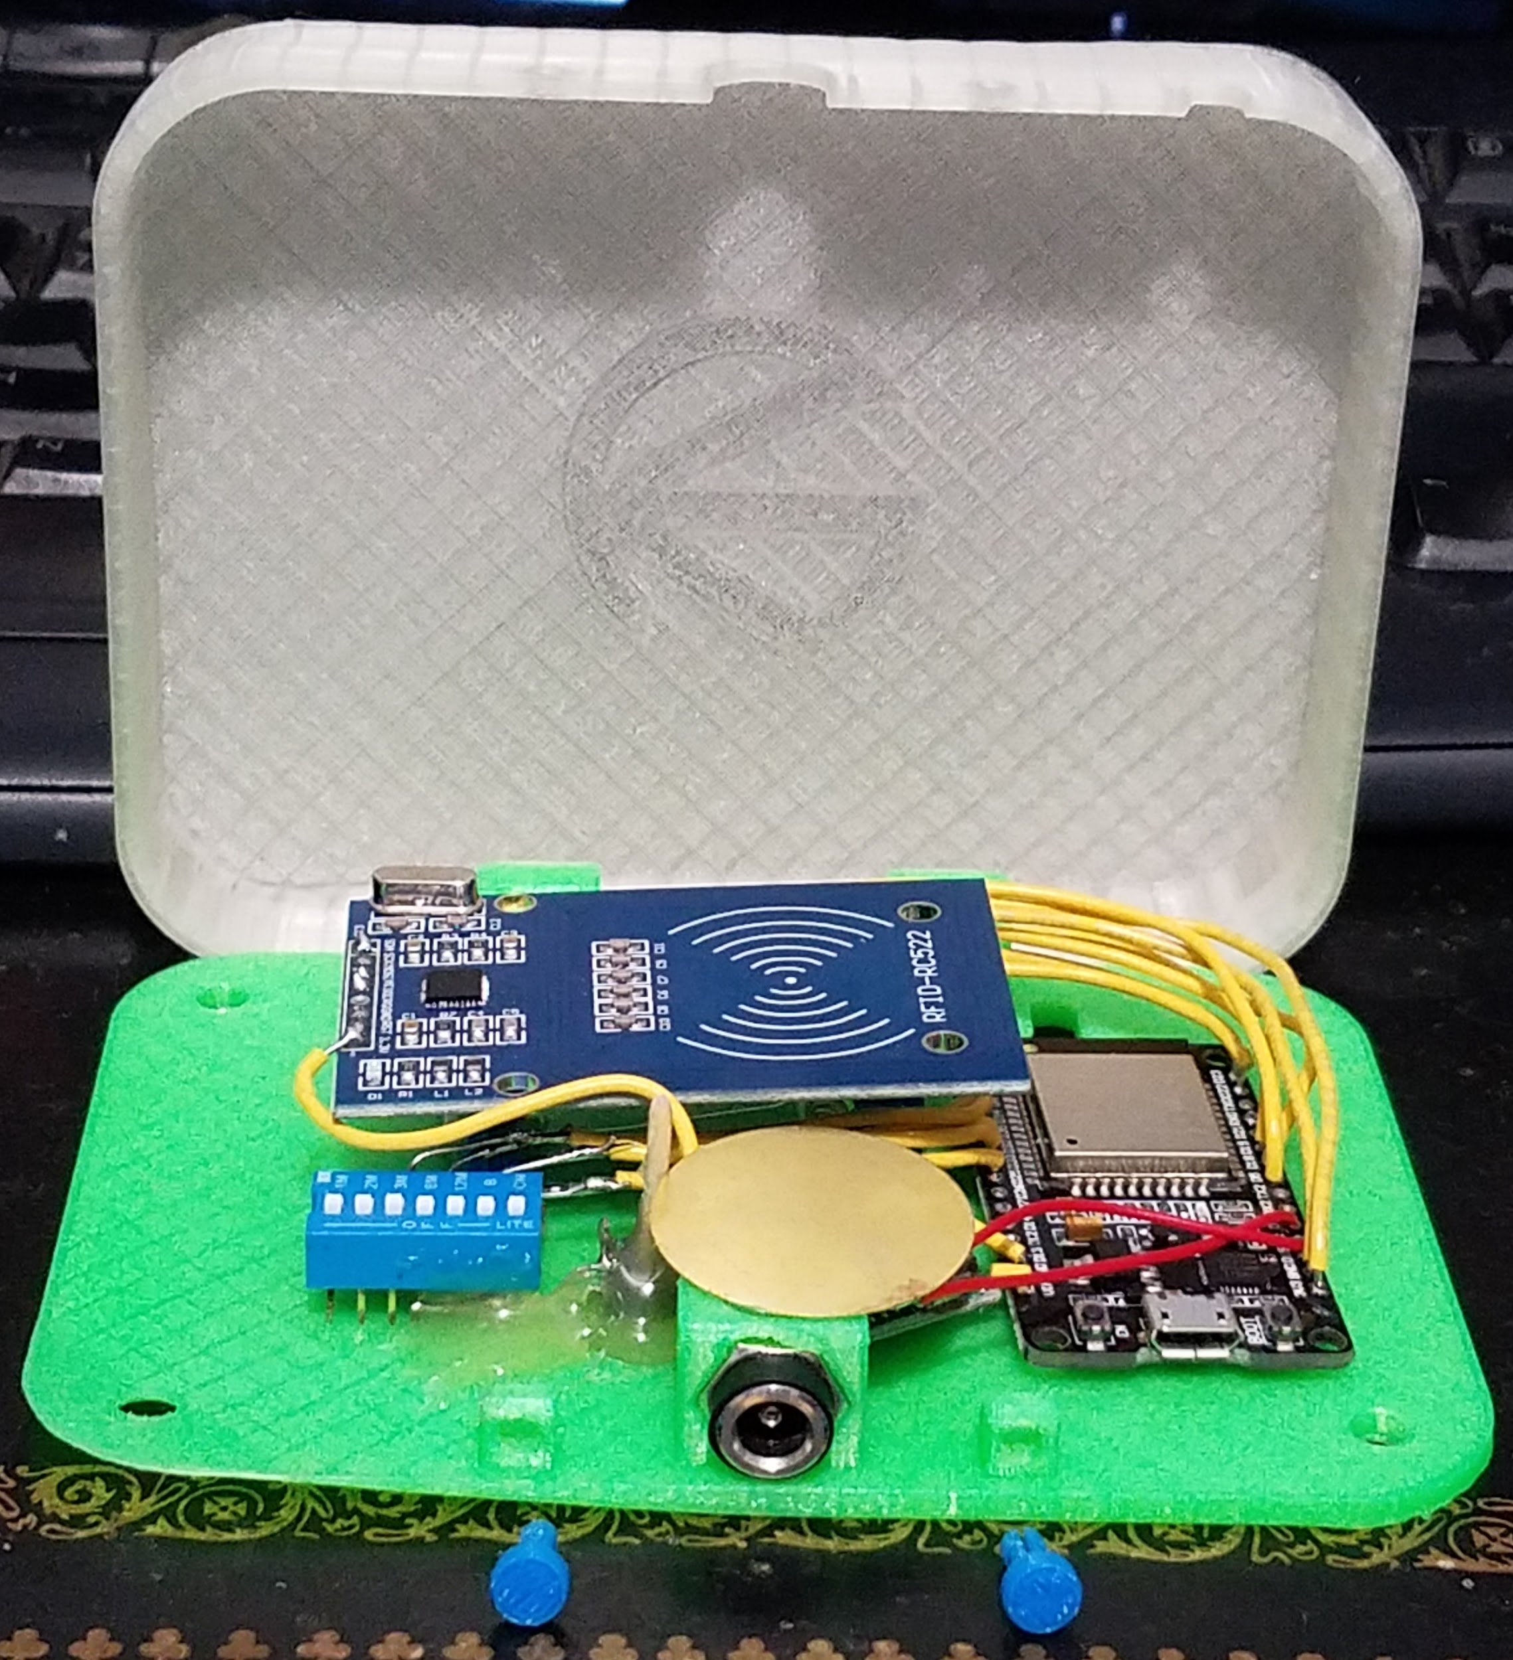
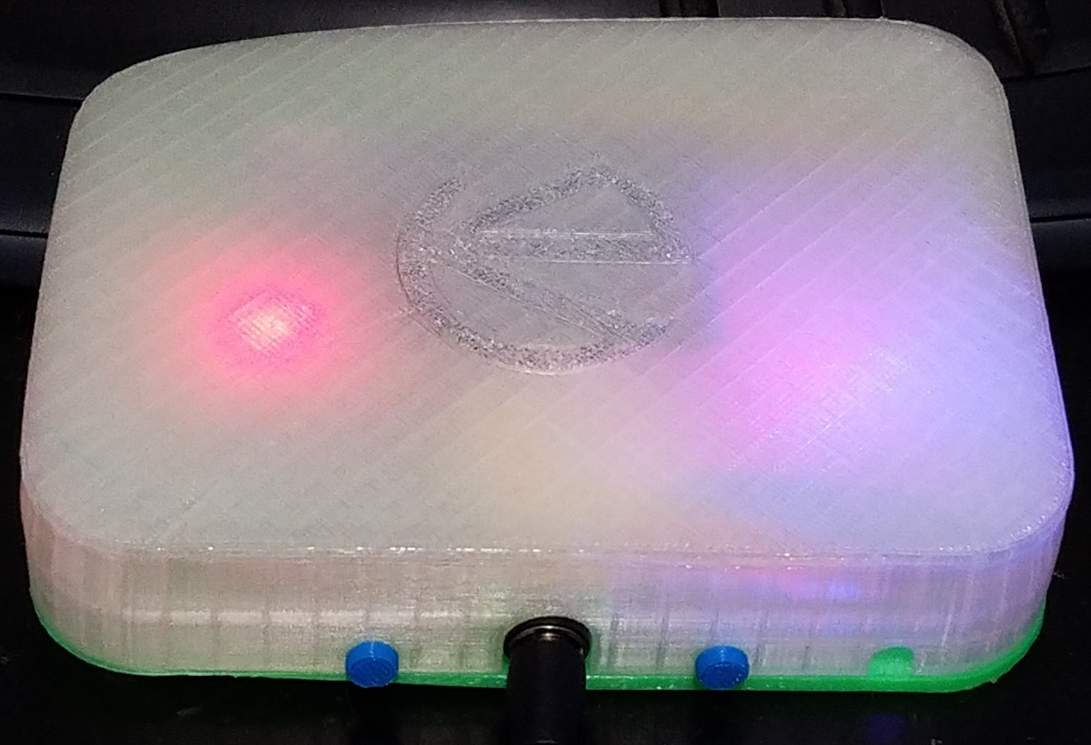
Implementation
Final case design
Using pin lock
23 hours of printing
5 hours of assembly
Point to point style

Slide 14
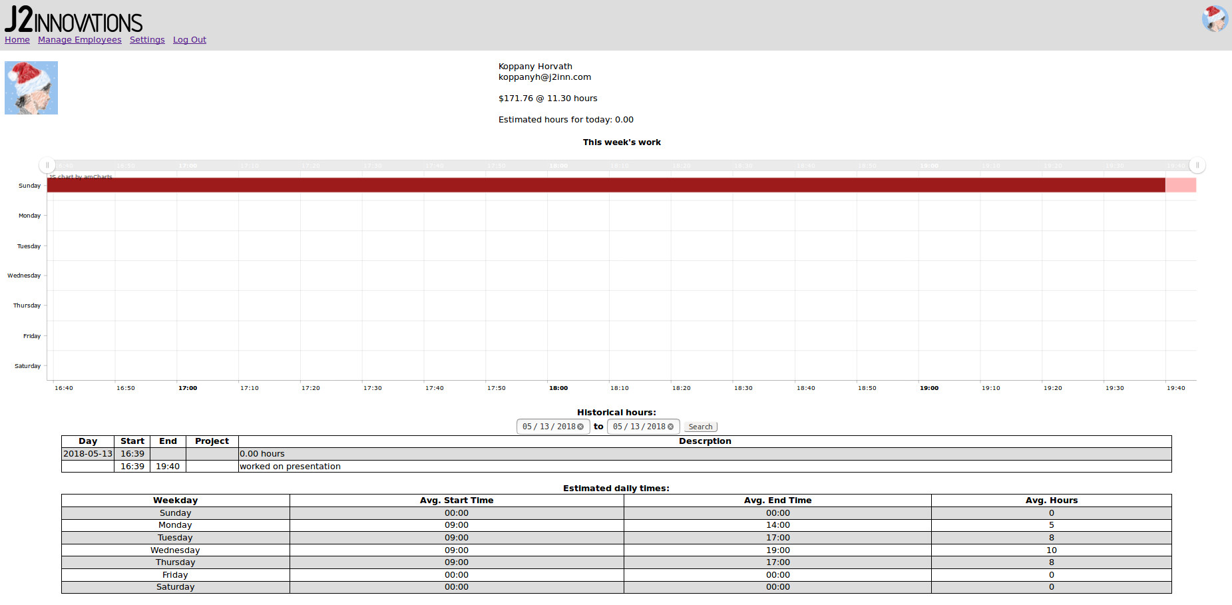
Implementation
Profile page
Work chart
Historical data
Estimated times
Profile pic
Update API

Slide 15
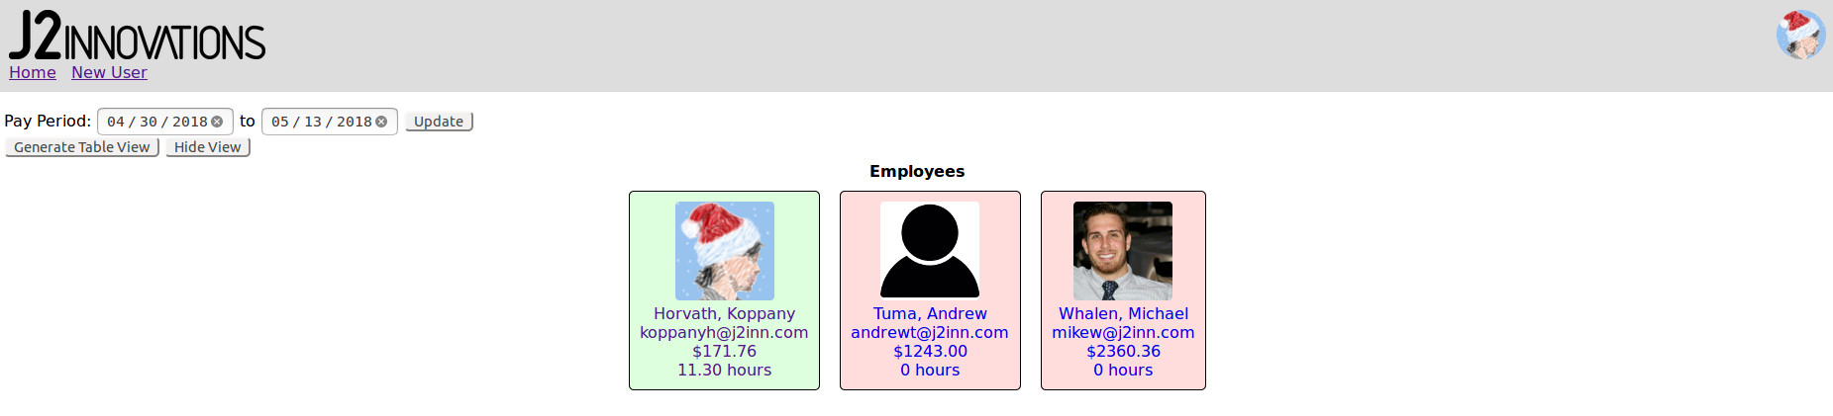
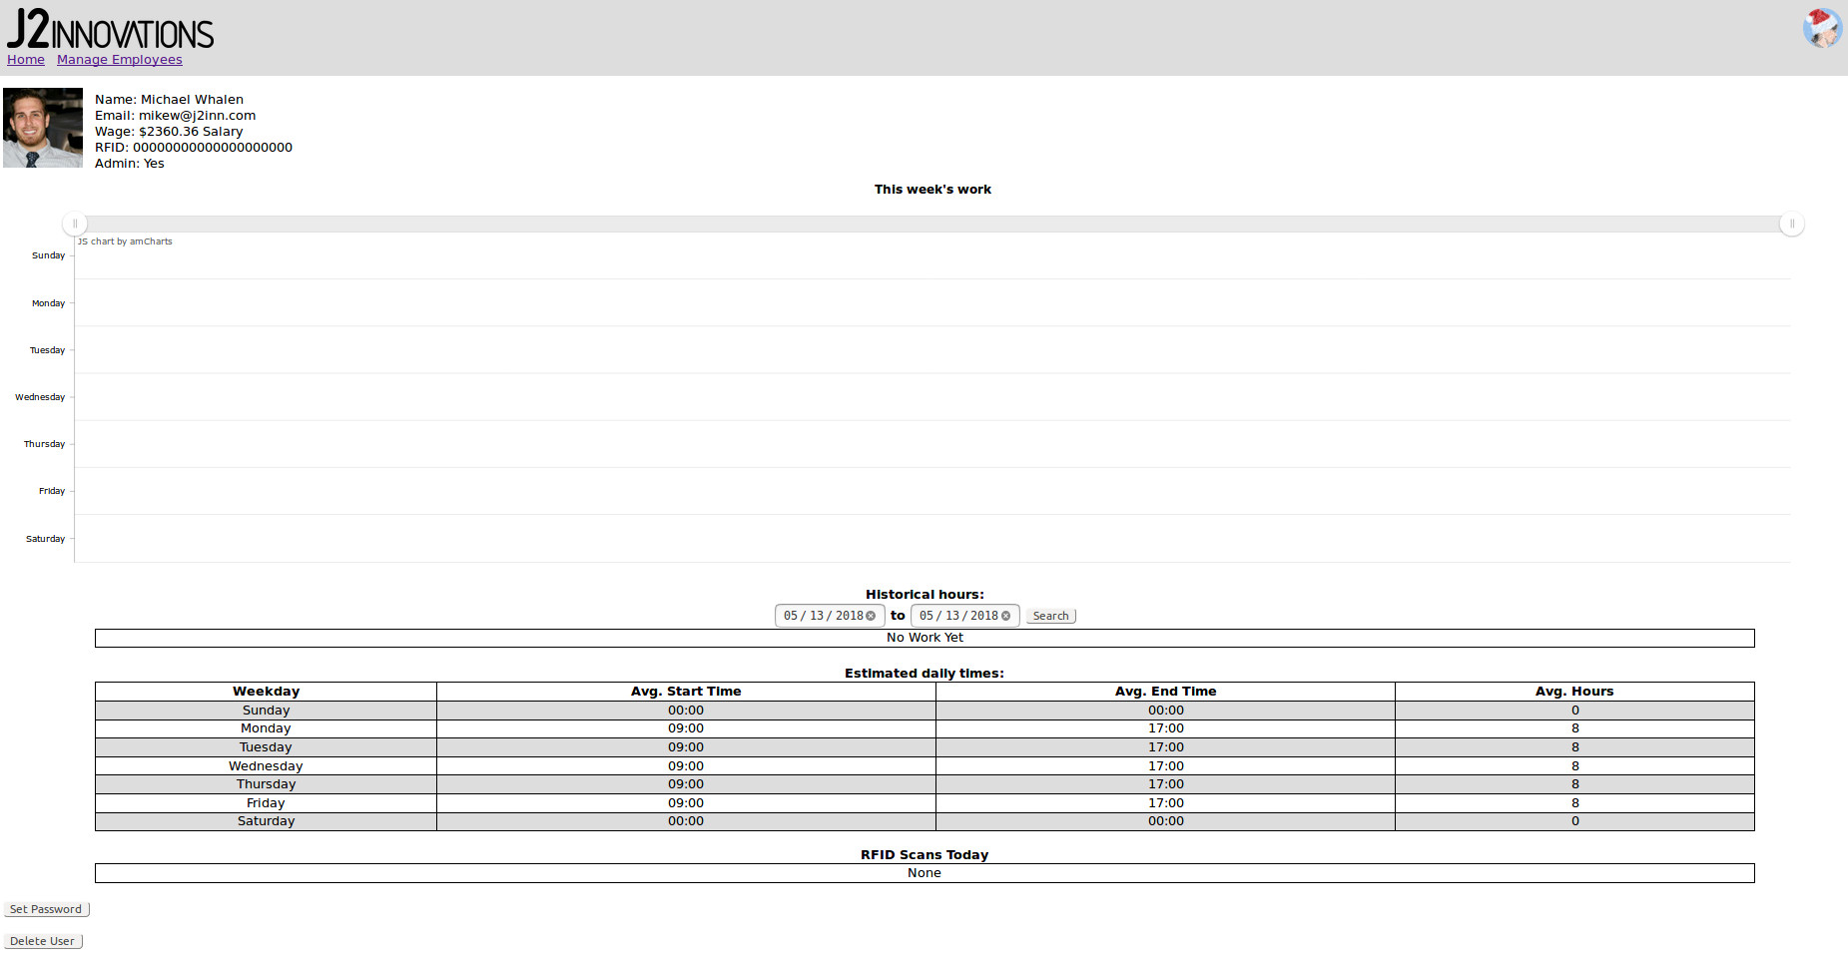
Implementation
User Management
View all users
See who’s clocked in
See profiles
Edit profiles
More API updates

Slide 16
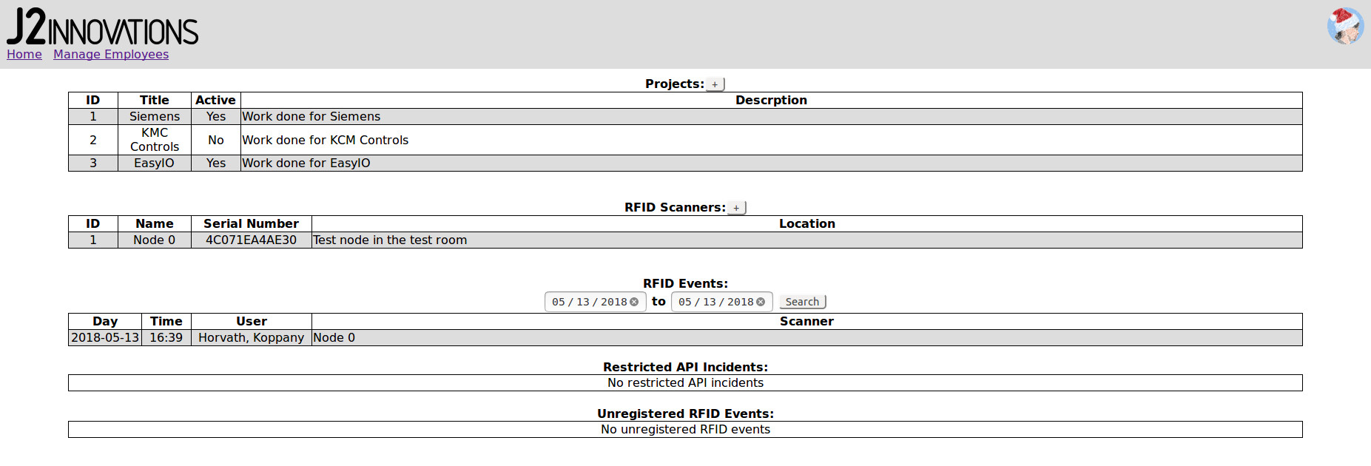
Implementation
Settings
Add / edit projects
Add / edit RFID scanners
View RFID events
View incidents
Even more API updates
Updates to database

Slide 17
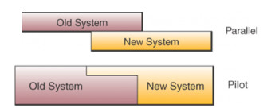
Implementation
End user training
Minimal for the employees
Slightly more for management
Setting up an RFID node
Using the management features in the UI
System conversion
Parallel or Pilot methods
Follow up plan
Continuous / regular monitoring
UI and feature updates

Slide 18
Operation
Operation
1) Scan card to clock in
2) Record what you do throughout the day
3) Scan card to clock out
Maintenance
Occasional database backup / cleaning
Policy addition
No changes to policy

Slide 19

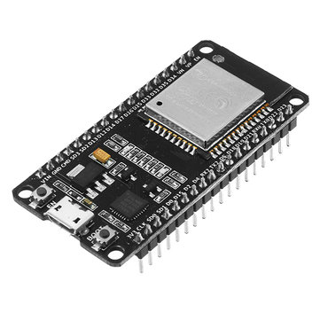
Lessons Learned
Asynchronous web programming
IOT firmware programming
Mechanical 3D printing design
REST API implementation

Slide 20

Limitations
Will not work well with multiple time zones
WiFi on RFID node sometimes doesn’t work
UI sometimes slowed by database access time
UI bugs cause infinite loading bar

Slide 21

User Satisfaction
10 / 10 Employees satisfied (projected value)

Slide 22
If I Did It Again...
More compact case design
Better case interior
No warped corner on case
Better assembly technique
More effort to UI styling

Slide 23
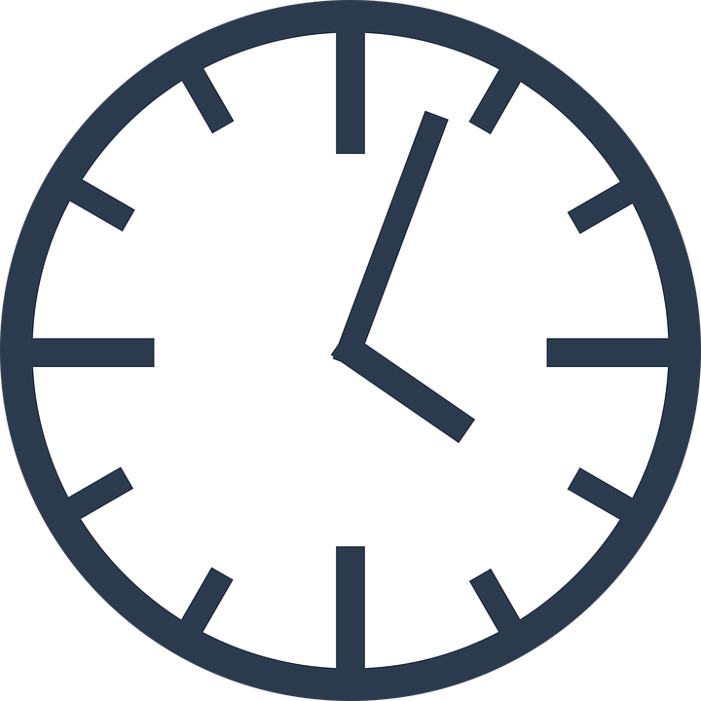
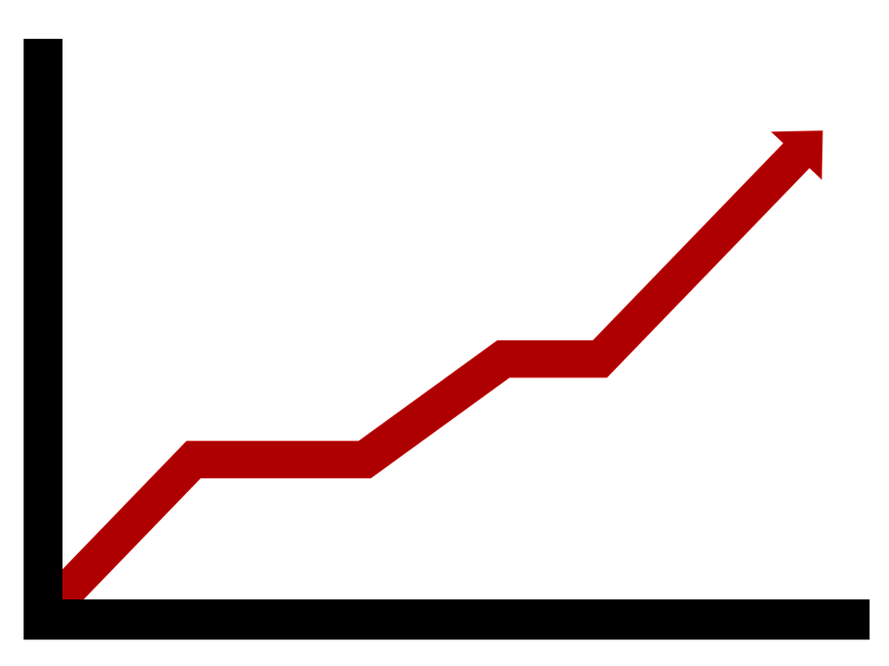
Future Expansion
Make a circular RFID node
Support multiple time zones
Dynamic reports / more charts for management
Track days off / vacation / sick days through the UI
Automatic server installer for easy setup

Slide 24
Conclusion
Learned a lot about product design
Learned a lot about web development
Came out exactly as I planned
Very few problems along the way
Overall very successful

Slide 25
Acknowledgements
CMPN 280: Computer Organization
CMPS 218: Publishing on the web 1
Professor Seta Whitby
Alvaro Alvarez

Slide 26

Questions?

